Slide 1
“SQL Task – Farmer & Market Insights”
Internship Program: Soulvibe.Tech
Name: Sandleen Sethi
Batch No: SVT/DAINT/2025/07-B11

Slide 2
Introduction
In this project, I analyzed agricultural data from farmers and market researchers using SQL. The objective was to generate actionable insights by writing queries to filter, join, and summarize the data. This helped in understanding crop patterns, farmer-advisor dynamics, and market alignment. I used SQL to uncover trends and answer key questions to support advisors and policymakers in data-driven decision-making.

Slide 3
Dataset overview
farmer_advisor_dataset: Contains farmer ID, crop, fertilizer, pesticide, yield.
market_researcher_dataset: Contains market ID, crop, price.
Simulation logic used: District, Advisor_ID, Growth Rate, PriceDate, Season.

Slide 4
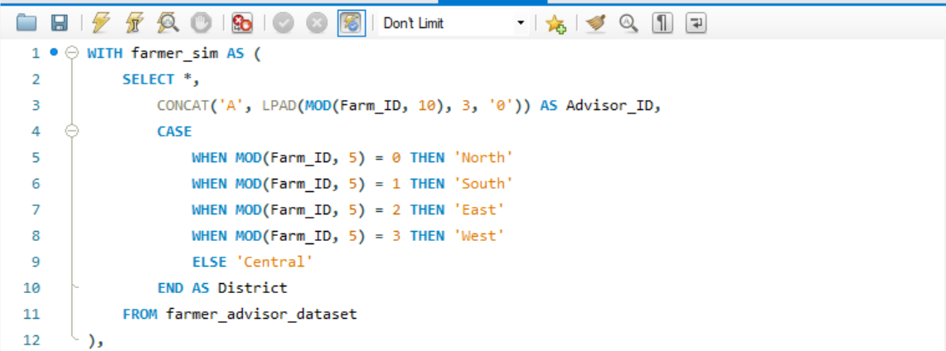
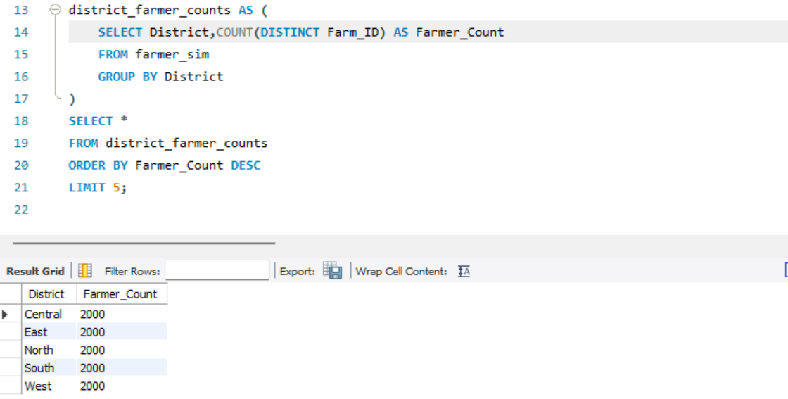
Query 1. Find the top 5 locations where the maximum number of farmers are associated with advisors.

Slide 5
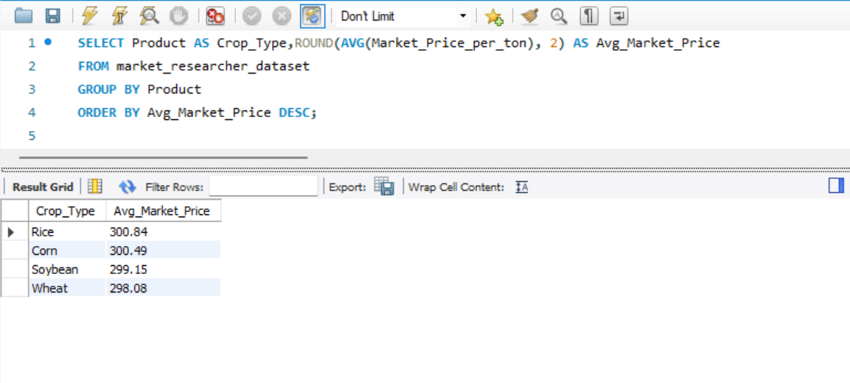
Query 2: For each crop type, calculate the average market price and sort in descending order.

Slide 6
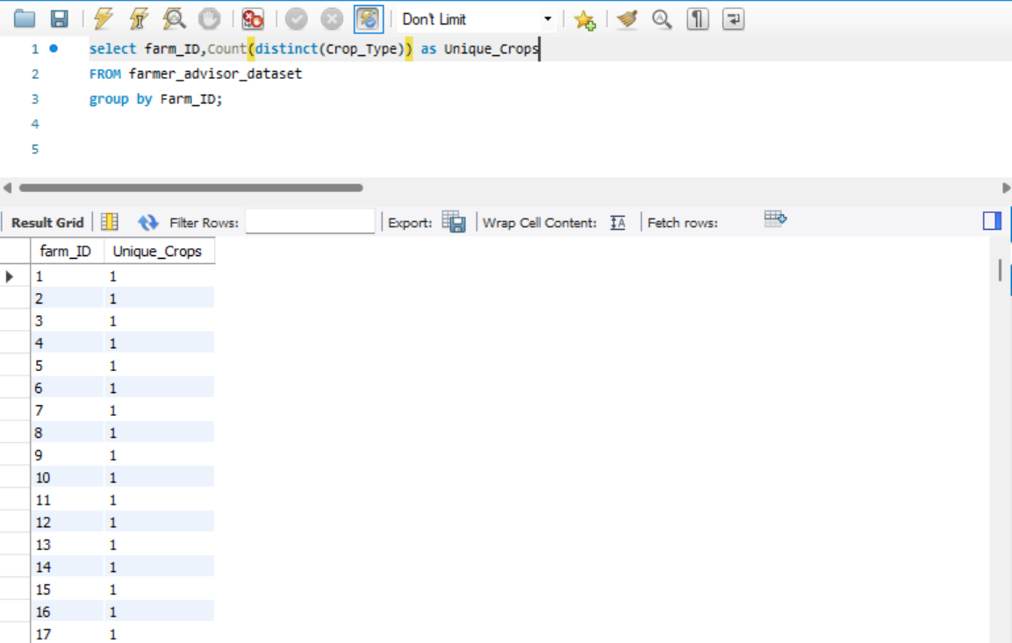
Query 3: Count how many unique crops each farmer is associated with.

Slide 7
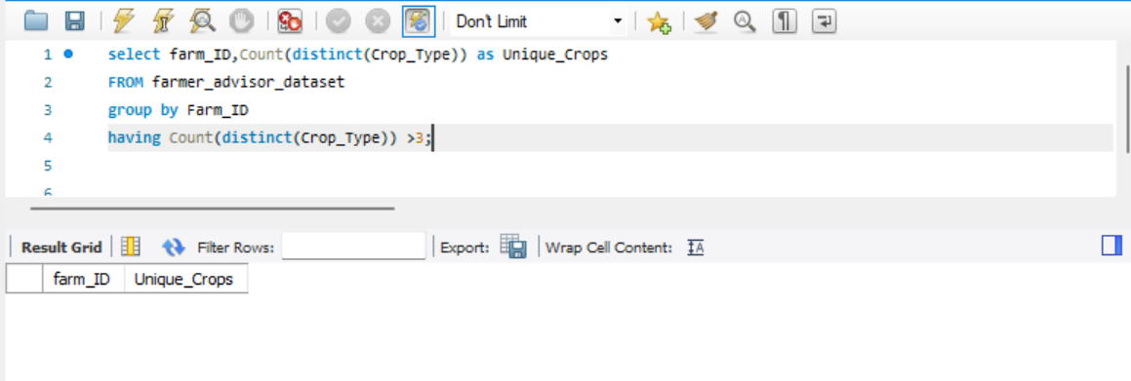
Query 4:Find farmers who are growing more than 3 different types of crops.

Slide 8
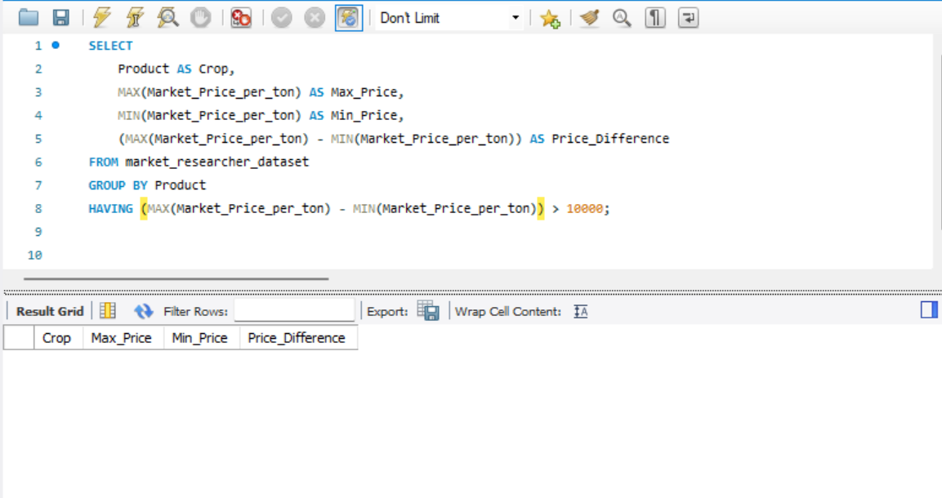
Query 5: List all crops where the max and min market prices (from MarketResearcher) differ by more than ₹10 per kg.

Slide 9
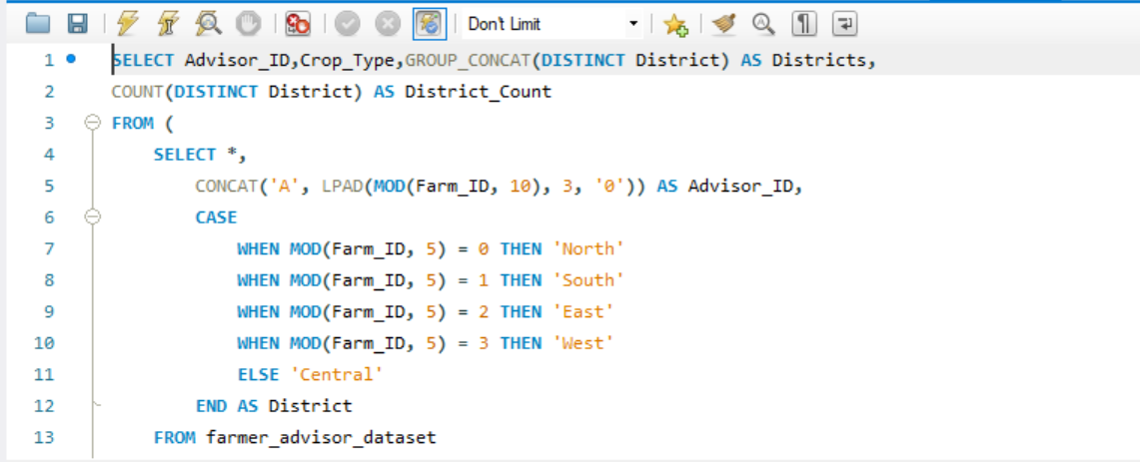
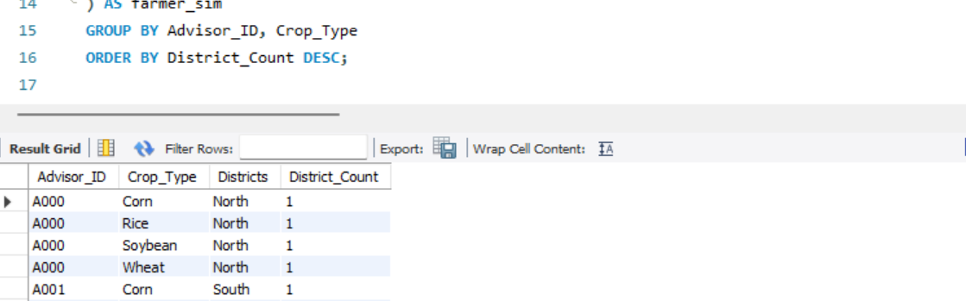
Query 6: Show all advisors who guide farmers growing the same crop in different districts.

Slide 10
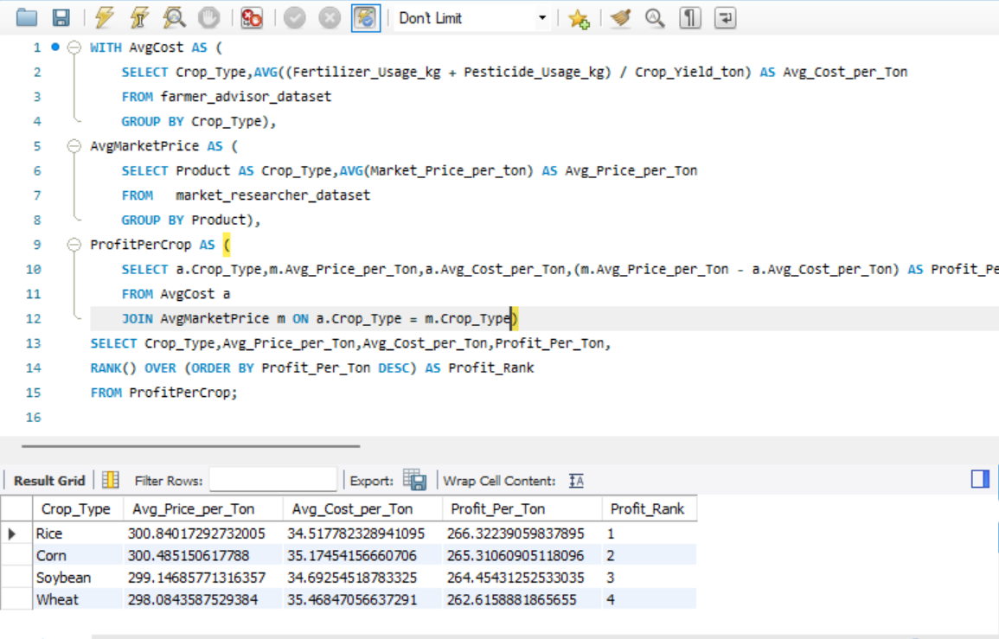
Query 7: Rank crops by profit per unit (assume: market price - average cost from FarmerAdvisor) using RANK().

Slide 11
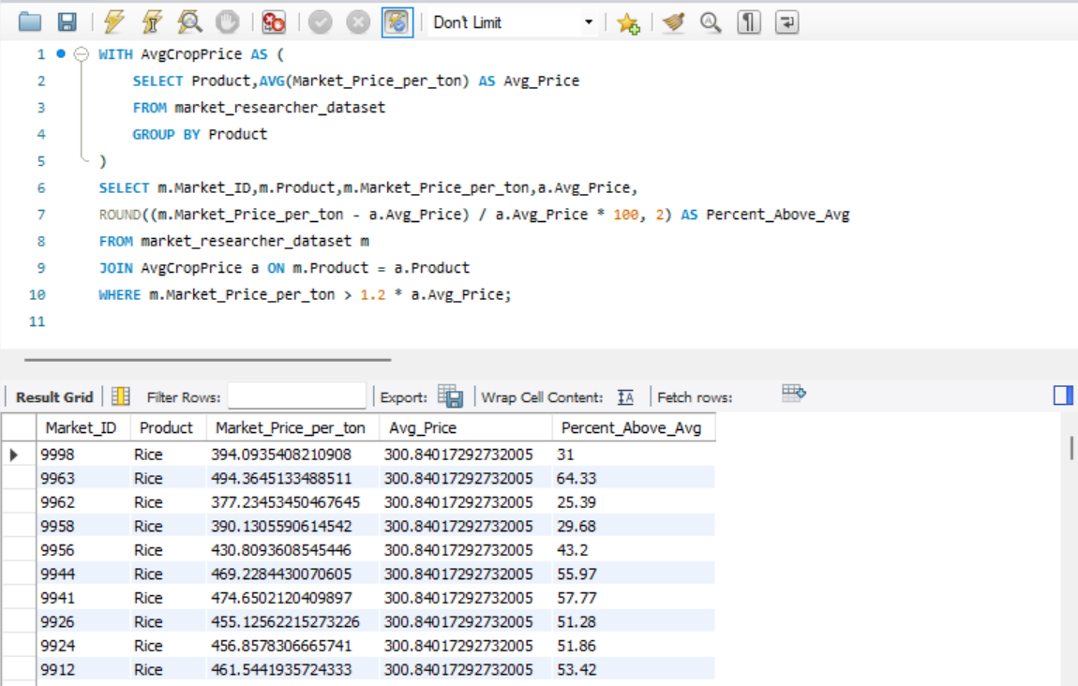
Query 8: Identify locations where the current market price of a crop is more than 20% above the average price of that crop across all locations.

Slide 12
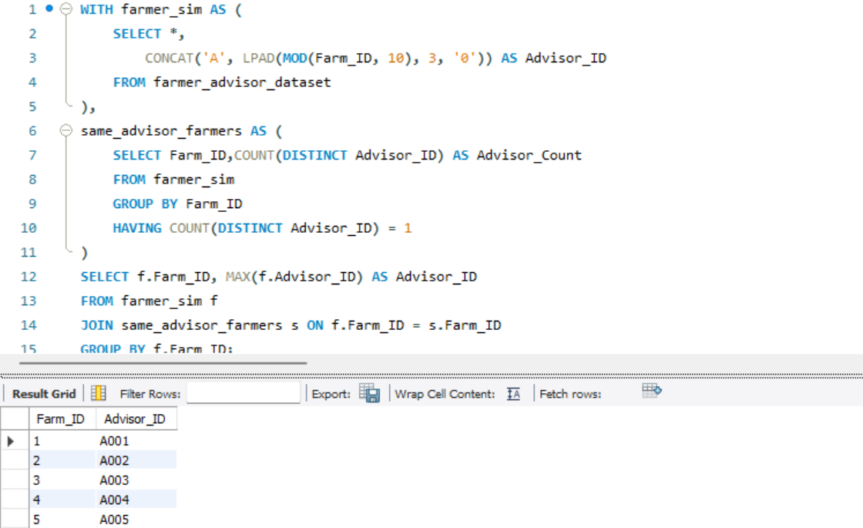
Query 9: List farmers who have been assigned the same advisor for all their crops.

Slide 13
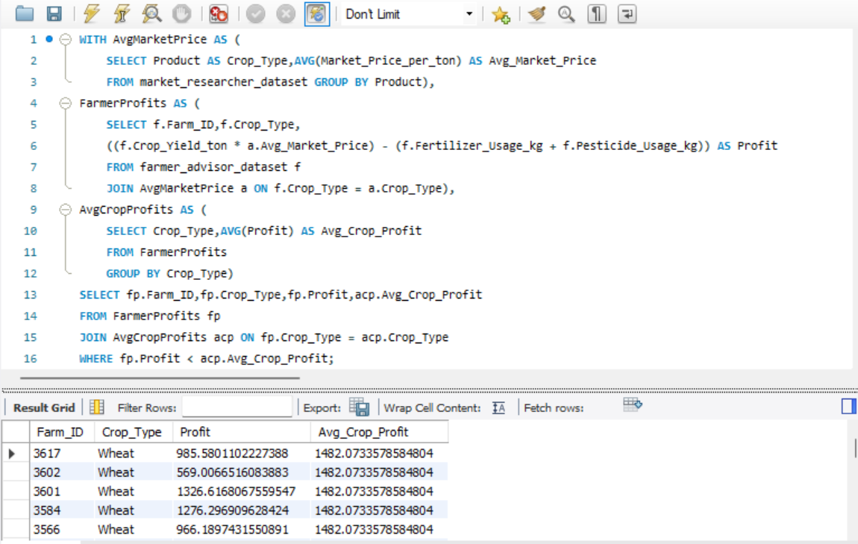
Query 10:Create a CTE showing average profit per crop type by farmer and use it to list farmers making below-average profits on any crop.

Slide 14
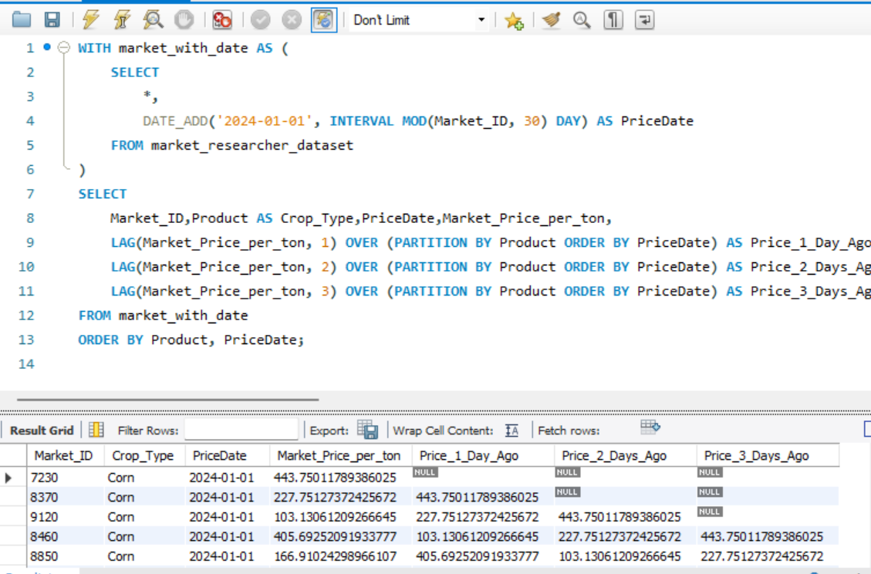
Query 11:(Assume MarketResearcher has a PriceDate) — Use a window function to find the price change of each crop over the last 3 entries.

Slide 15
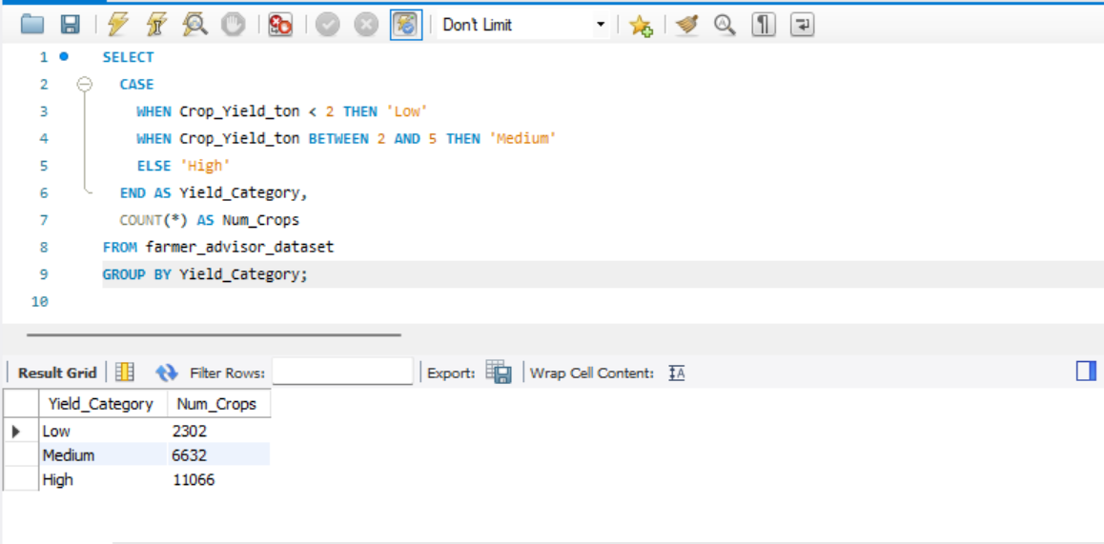
Query 12: Create a new column that classifies crop growth rate as: - Low (<20%) - Medium (20–50%) - High (>50%) Count the number of crops in each category.

Slide 16
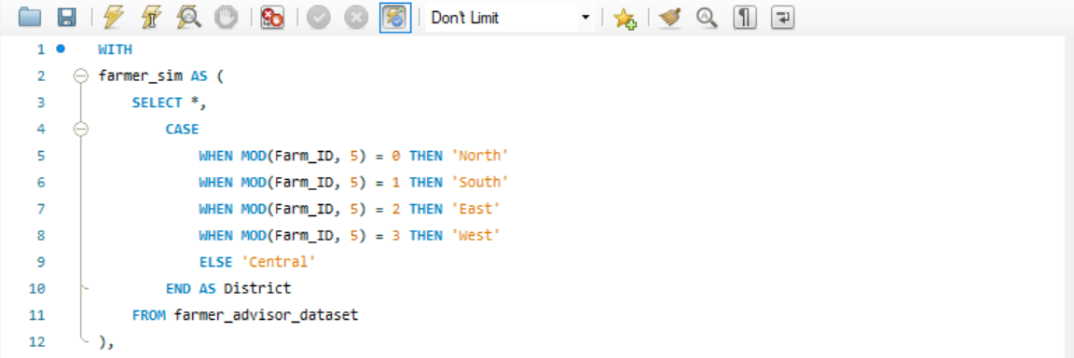
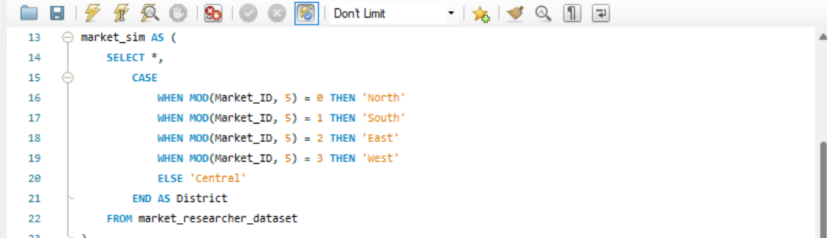
Query 13: Join the tables and display all farmers whose crop is sold in the same district at the highest price

Slide 17
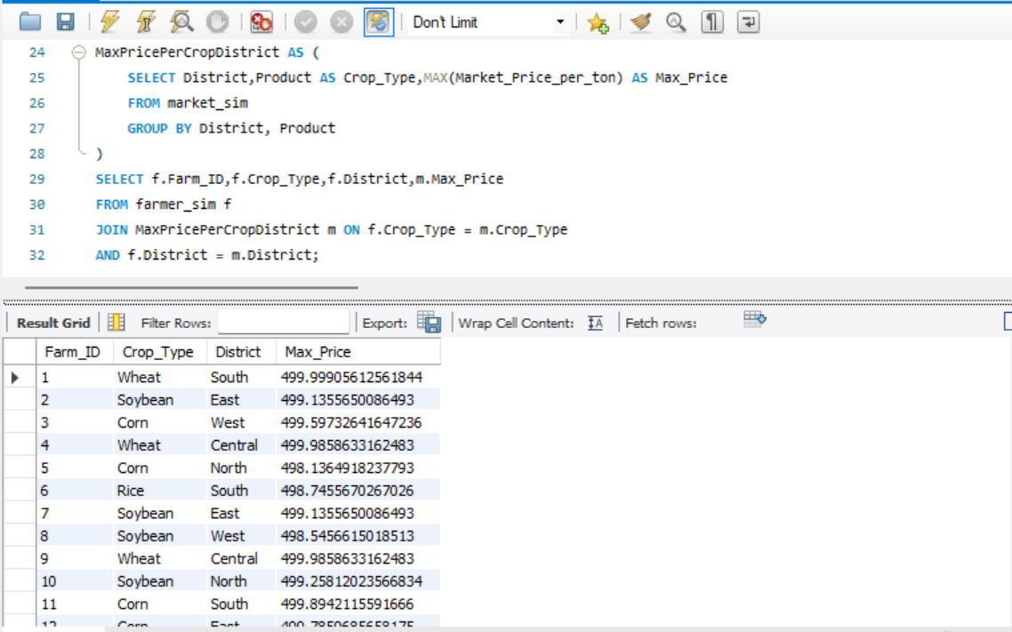
Query 13 (Continued):

Slide 18
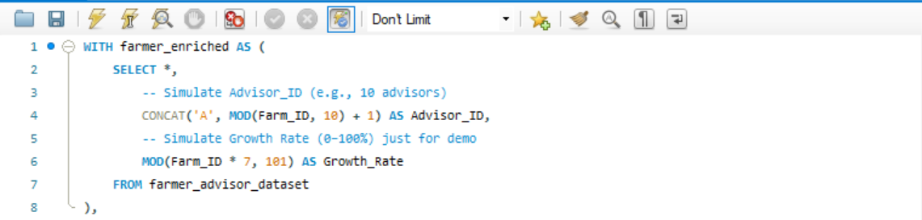
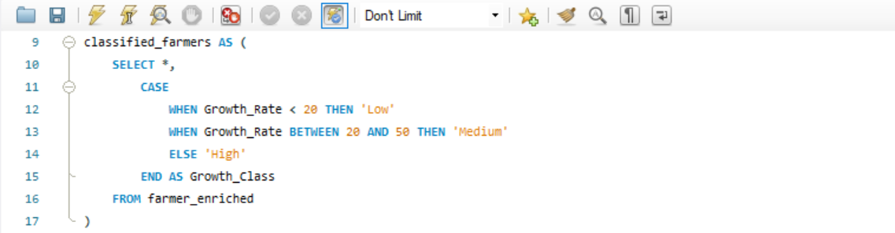
Query 14: For each advisor, count how many of their farmers grow crops that fall under the “High” growth classification (from Q12).

Slide 19
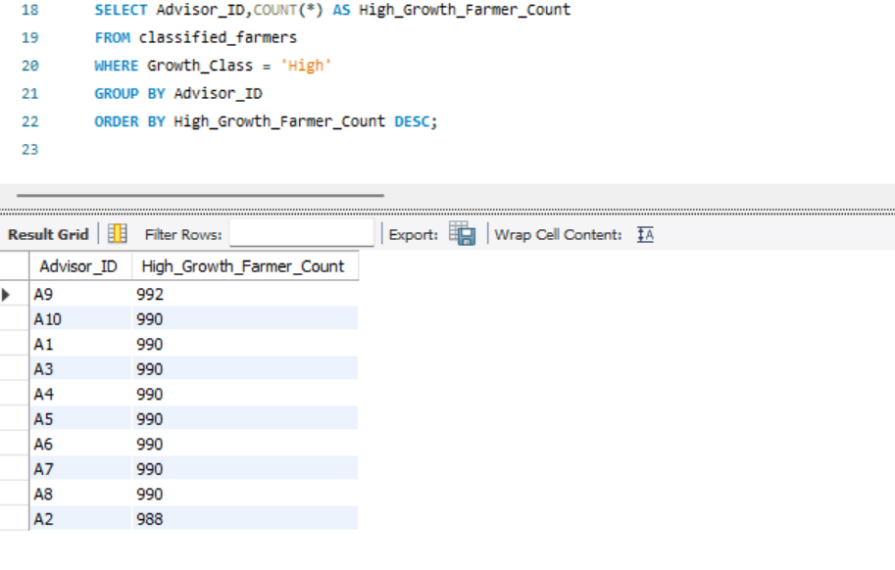
Query 14(continued):

Slide 20
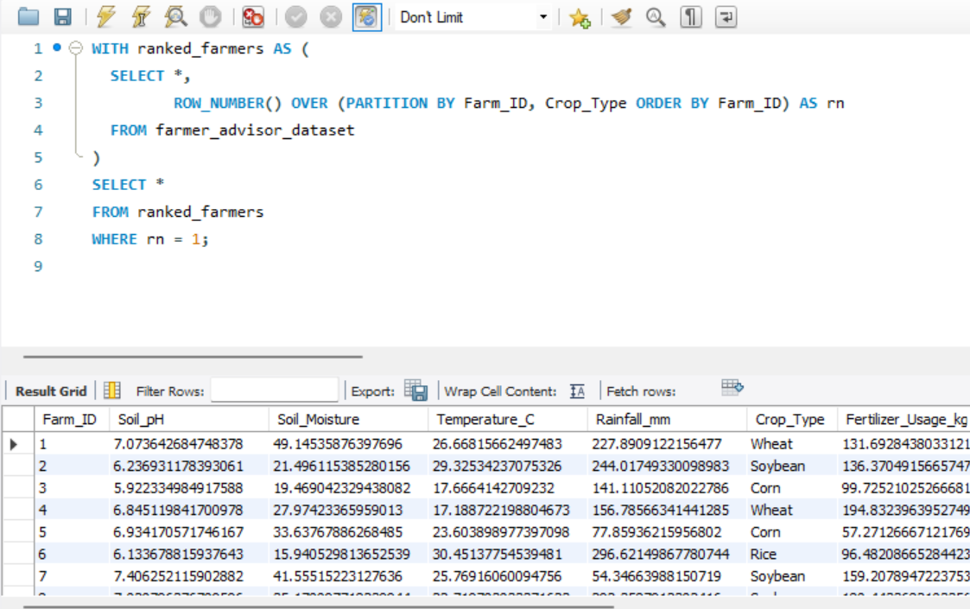
Query 15:Identify if any farmer has duplicate crop entries.

Slide 21
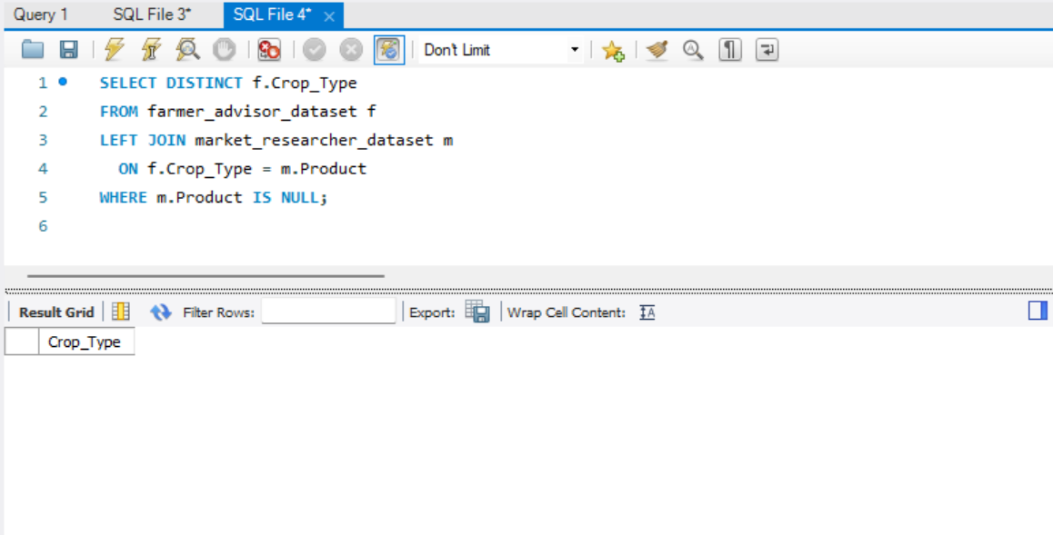
Query 16: List all crops grown by farmers that are not listed in the MarketResearcher table.

Slide 22
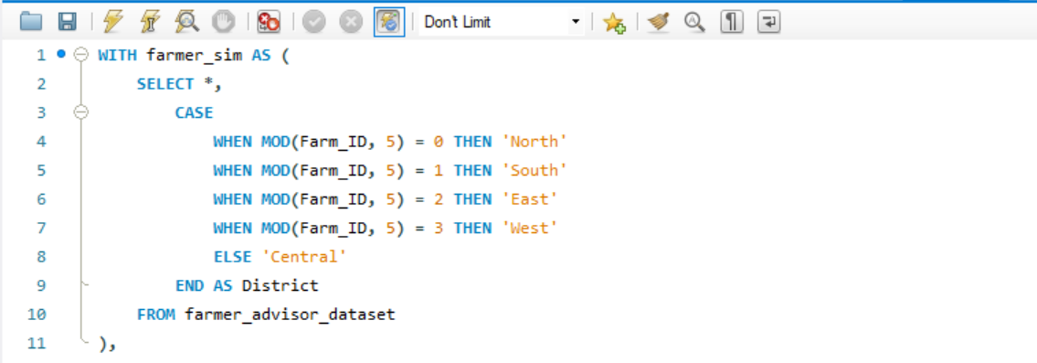
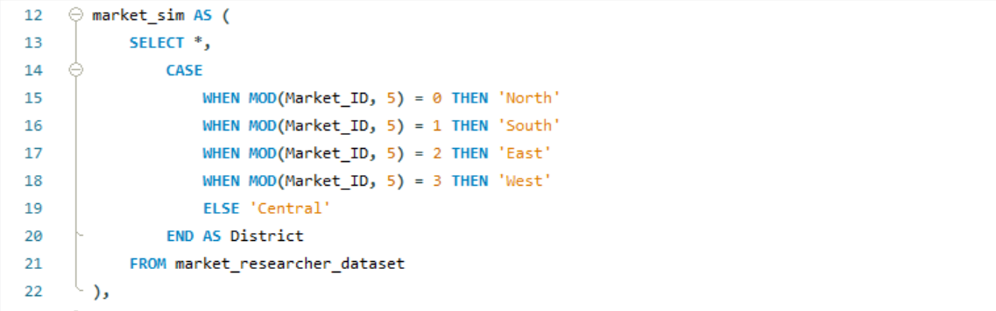
Query 17: For each crop, determine which location has the highest average profit margin.

Slide 23
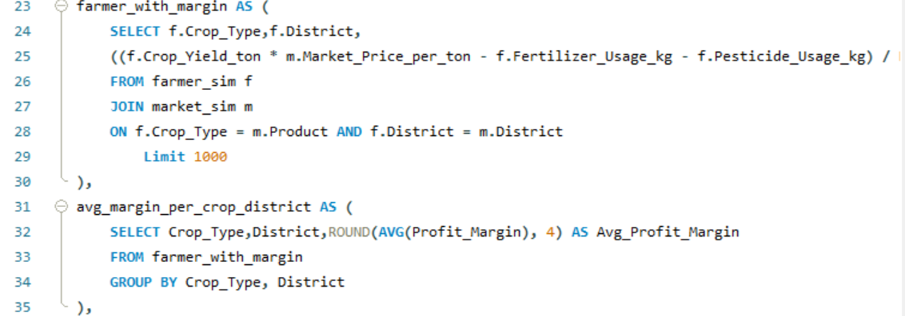
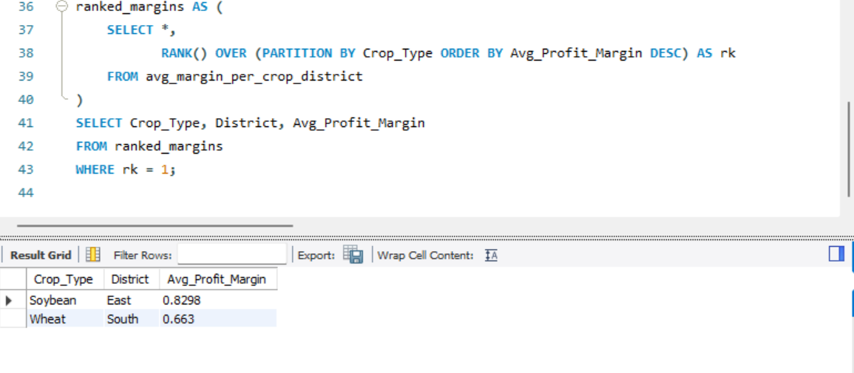
Query 17(continued):

Slide 24
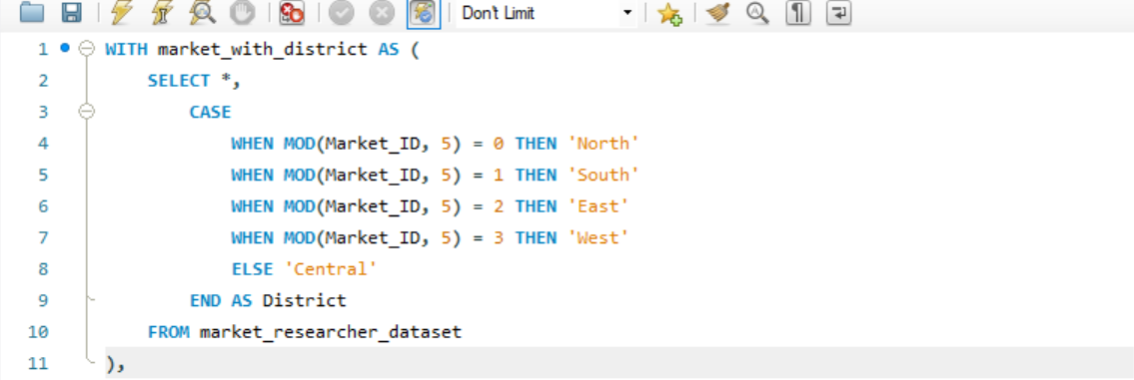
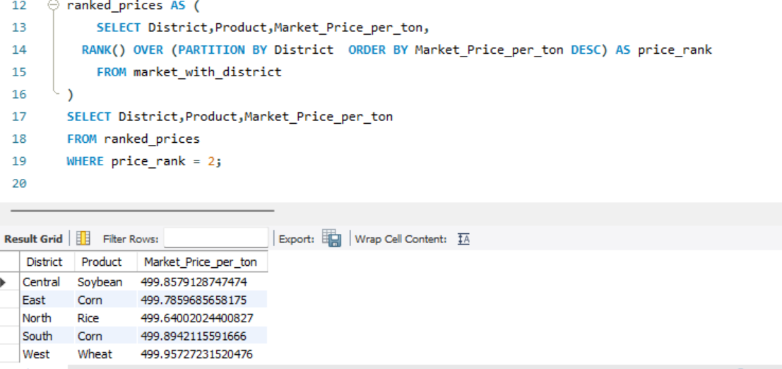
Query 18:Use window functions to find the second-highest market price crop per district.

Slide 25
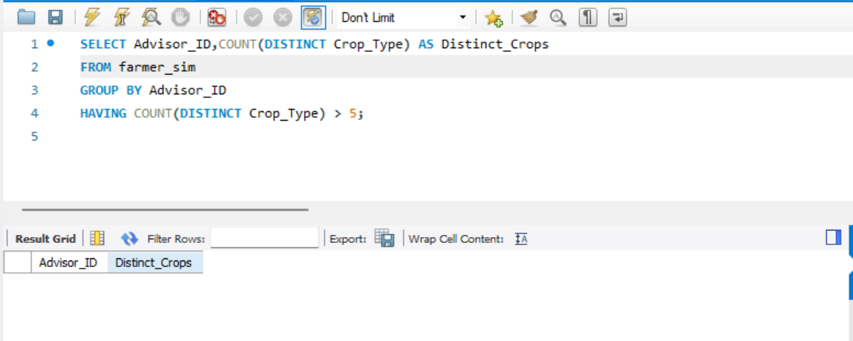
Query 19: List all advisors associated with more than 5 distinct crop types.

Slide 26
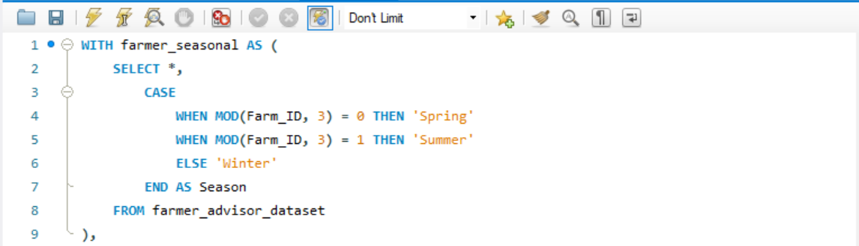
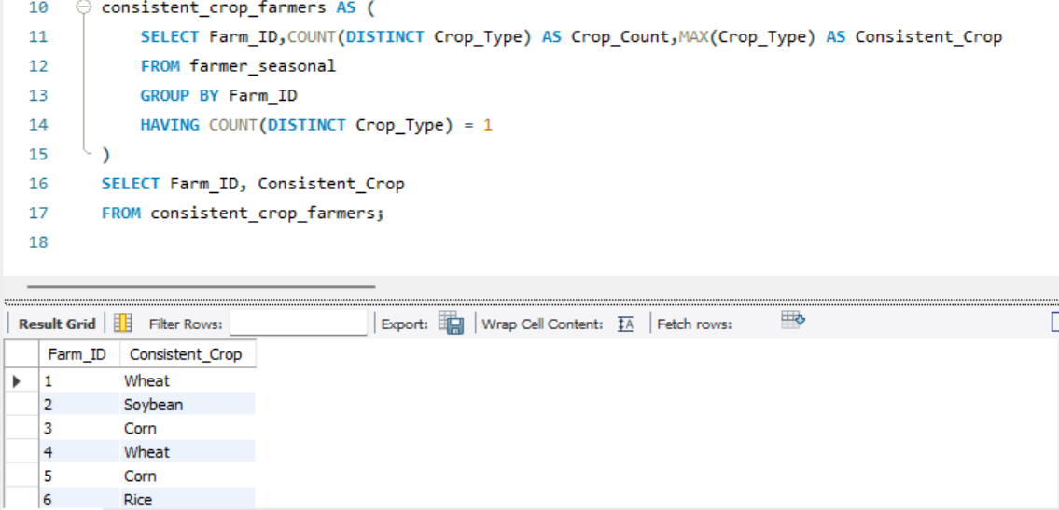
Query 20: Find farmers who consistently grow the same crop type for all seasons (assume a Season column exists or mock one for the exercise).

Slide 27
Key Insights
Farmer distribution is uniform across all districts (2000 each).
Rice is the most profitable crop, followed by corn and saffron.
Wheat shows the highest price volatility.
No advisors operate across multiple districts for the same crop.
No farmers grow more than three different crops.
Some farmers rely on a single advisor for all crops..

Slide 28

Thank you
Contact:
sandleensethi09@gmail.com

